Slide 1
Prove that 2-sat is in p
By Fatemeh Barati

Slide 2
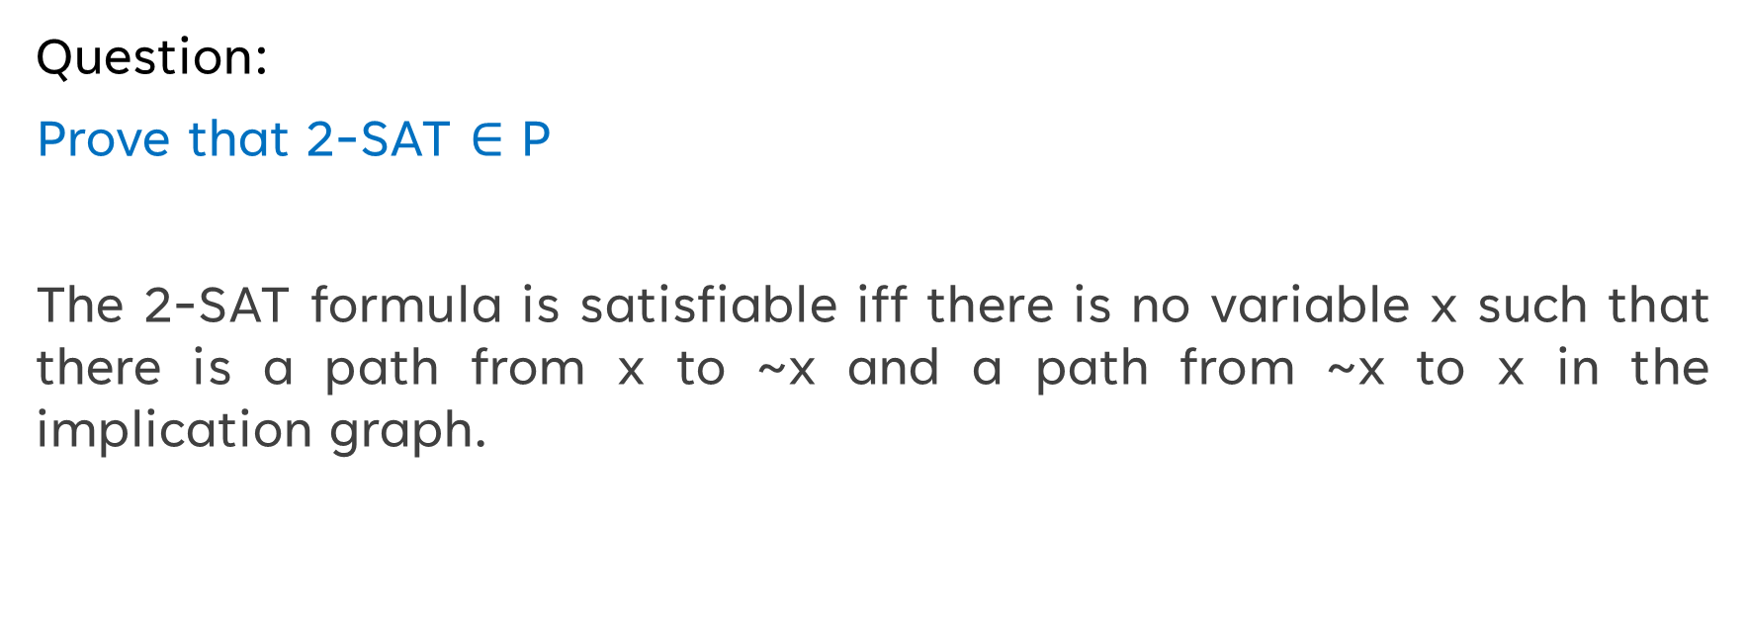
Question:
Prove that 2-SAT $∈$ P
The 2-SAT formula is satisfiable iff there is no variable x such that there is a path from x to ~x and a path from ~x to x in the implication graph.

Slide 3



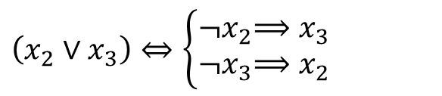

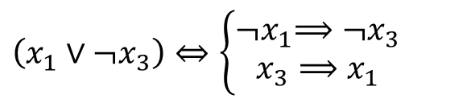

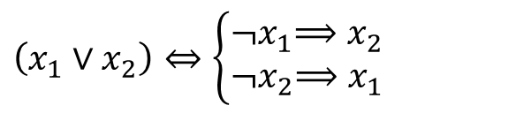

An example of 2-SAT:
$$(x_{1}∨x_{2})∧(x_{1}∨{¬x}_{3})∧(x_{2}∨x_{3})$$
$$\left(x_{1}∨x_{2}\right)⇔\left\{\begin{aligned}{¬x}_{1}⟹x_{2} \\ {¬x}_{2}⟹x_{1}\end{aligned}\right.$$
$$x_{1}$$
$$x_{2}$$
$$\left(x_{1}∨{¬x}_{3}\right)⇔\left\{\begin{aligned}{¬x}_{1}⟹{¬x}_{3} \\ x_{3}⟹x_{1}\end{aligned}\right.$$
$${¬x}_{3}$$
$$x_{3}$$
$$\left(x_{2}∨x_{3}\right)⇔\left\{\begin{aligned}{¬x}_{2}⟹x_{3} \\ {¬x}_{3}⟹x_{2}\end{aligned}\right.$$
$${¬x}_{2}$$
$${¬x}_{1}$$

Slide 4
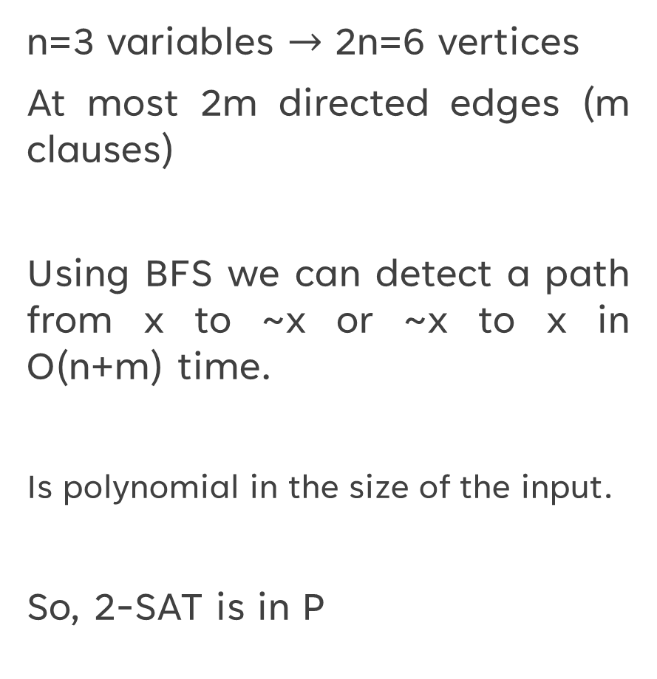
n=3 variables $→$ 2n=6 vertices
At most 2m directed edges (m clauses)
Using BFS we can detect a path from x to ~x or ~x to x in O(n+m) time.
Is polynomial in the size of the input.
So, 2-SAT is in P
$$x_{1}$$
$$x_{2}$$
$${¬x}_{3}$$
$$x_{3}$$
$${¬x}_{2}$$
$${¬x}_{1}$$

Slide 5

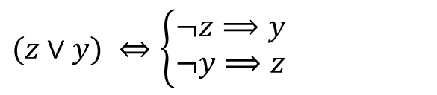


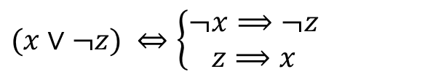

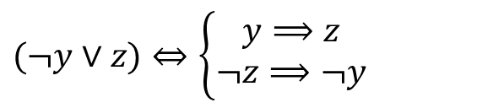

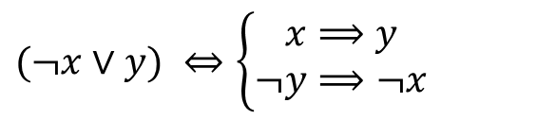

Another example of 2-SAT:
there is a path from ~x to x, ~y to y, and ~z to z; but there is no path from x to ~x, y to ~y and z to ~z. So, 2-SAT formula is satisfiable.
$$(¬x∨y)∧(¬y∨z)∧(x∨¬z)∧(z∨y)$$
$$(¬x∨y) ⇔\left\{\begin{aligned}x⟹y \\ ¬y⟹¬x\end{aligned}\right.$$
$$x$$
$$y$$
$$(¬y∨z)⇔\left\{\begin{aligned}y⟹z \\ ¬z⟹¬y\end{aligned}\right.$$
$¬$z
$$z$$
$$(x∨¬z) ⇔\left\{\begin{aligned}¬x⟹¬z \\ z⟹x\end{aligned}\right.$$
$¬$y
$¬$x
$$(z∨y) ⇔\left\{\begin{aligned}¬z⟹y \\ ¬y⟹z\end{aligned}\right.$$

